Slide 1
Chapter - 11
Printer Configuration

Slide 2
Objectives:
At the end of this module, you would have gained fair knowledge on:
Configuring a printer
Sharing a printer

Slide 3
The printconf application allows users to configure a printer in Red Hat Linux. It helps maintain the /etc/printcap configuration file, print spool directories, and print filters.
The printconf application configures the printing system called LPRng. LPRng is also the default printing system. This chapter focuses on using Printconf to configure LPRng.

Slide 4
To use printconf, you must have root privileges.
To start printconf, use one of the following methods:
• On the GNOME desktop, select Main Menu Button (on the Panel) => Programs => System => Printer Configuration to start the graphical version.
• On the KDE desktop, select Main Menu Button (on the Panel) => System => Printer Configuration to start the graphical version.
• Type the command printconf-gui at a shell prompt (for example, in an XTerm or a GNOME terminal) to start the graphical version.
You can also run printconf as a text-based application if you do not have the X Window System installed, or you just prefer the text-based interface. To run it, log in as root (or use the command su to temporarily change to the root user), and type the command /usr/sbin/printconf-tui from a shell prompt

Slide 5
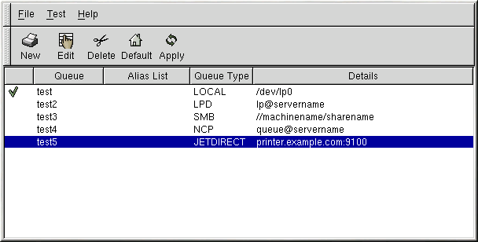
If you want to add a printer without using printconf, edit the /etc/printcap.local file. The entries in /etc/printcap.local are not displayed in printconf but are read by the printer daemon

Slide 6
Five types of print queues can be configured with printconf
• Local Printer — a printer attached directly to your computer through a parallel or USB port.
• Unix Printer (lpd Spool) — a printer attached to a different UNIX system that can be accessed over a TCP/IP network
• Windows Printer (SMB) — a printer attached to a different system which is sharing a printer over a SMB network
• Novell Printer (NCP Queue) — a printer attached to a different system which uses Novell's NetWare network technology.
• JetDirect Printer — a printer connected directly to the network instead of to a computer.

Slide 7
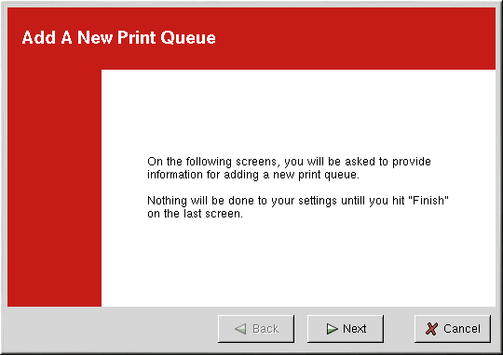
Adding a Local Printer
To add a local printer such as one attached to the parallel port or USB port of your computer, click the New button in the main printconf window. The window shown in figure below will appear. Click Next to proceed.

Slide 8
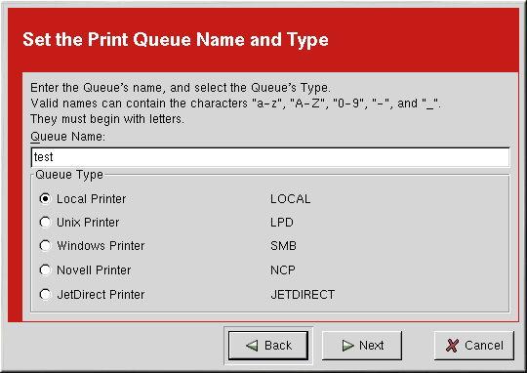

Slide 9
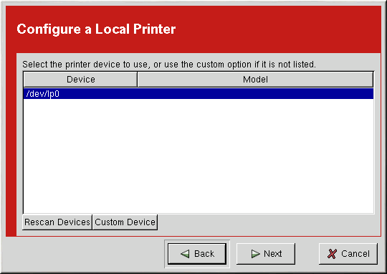

Slide 10
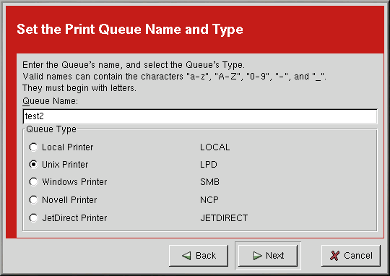
Adding a Remote UNIX Printer
To add a remote UNIX printer, such as one attached to a different Linux system on the same network, click the New button in the main printconf window. Click Next to proceed
Select Unix Printer from the Queue Type menu, and click Next.

Slide 11
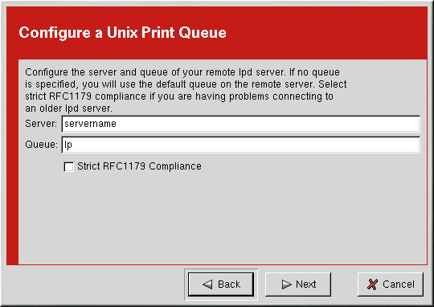
Text fields for the following options appears as shown in the next figure.
1. Server — The hostname or IP address of the remote machine to which the printer is attached.
2. Queue — The remote printer queue. The default printer queue is usually lp.

Slide 12
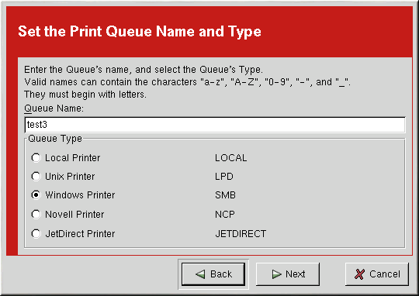
Adding a Samba (SMB) Printer
To add printer which is accessed using the SMB protocol, click the New button in the main printconf window. The window shown in next figure will appear. Click Next to proceed.
Select Windows Printer from the Queue Type menu, and click Next. If the printer is attached to a Microsoft Windows system, choose this queue type

Slide 13
Adding a SMB Printer
Text fields for the following options appear as shown in below figure:
• Share — The name of the shared printer on which you want to print. This name must be the same name defined as the Samba printer on the remote Windows machine. Notice the syntax of //machinename/sharename.
• User — The name of the user you must log in as to access the printer. This user must exist on the Windows system, and the user must have permission to access the printer. The user name is typically guest for Windows servers, or nobody for Samba servers.
• Host IP — The hostname or IP address of the remote system that is sharing the SMB printer.
• Password — The password (if required) for the user specified in the User field.
• Workgroup — The name of the workgroup on the machine running Samba.

Slide 14
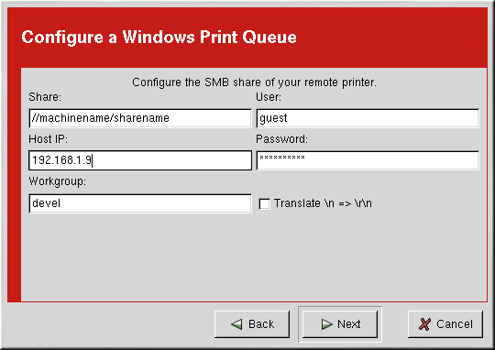

Slide 15
Adding a Novell NetWare (NCP) Printer
To add a Novell NetWare (NCP) printer, click the New button in the main printconf window. Then click Next to proceed.
You will see the screen shown in below figure. Enter a unique name for the printer in the Queue Name text field. The printer name cannot contain spaces and must begin with a letter a through z or A through Z. The valid characters are a through z, A through Z, 0 through 9, -, and _.

Slide 16
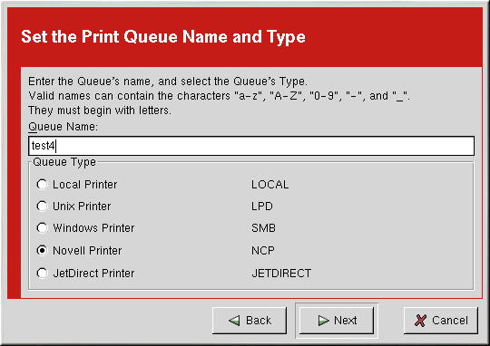
Select Novell Printer from the Queue Type menu, and click Next.

Slide 17
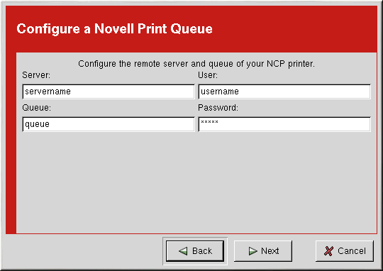
Text fields for the following options appear below the Queue Type menu as shown in as the figure given below:
• Server — The hostname or IP address of the NCP system to which the printer is attached.
• Queue — The remote queue for the printer on the NCP system.
• User — The name of the user you must log in as to access the printer.
• Password — The password for the user specified in the User field above.

Slide 18
Adding a JetDirect Printer
To add a JetDirect printer, click the New button in the main printconf window. Click Next to proceed.
You will see the screen shown in as figure given below. Enter a unique name for the printer in the Queue Name text field. The printer name cannot contain spaces and must begin with a letter a through z or A through Z. The valid characters are a through z, A through Z, 0 through 9, -, and _.
Select JetDirect Printer from the Queue Type menu, and click Next

Slide 19


Slide 20
Selecting the Print Driver and Finishing
After selecting the queue type of the printer, the next step in adding a printer is to select the print driver.
You will see a window similar to figure given below. If you are configuring a local printer, select the print driver from the list. The printers are divided by manufacturers.
Click the arrow beside the manufacturer for your printer. Find your printer from the expanded list, and click the arrow beside the printer name. A list of drivers for your printer will appear. Select one

Slide 21
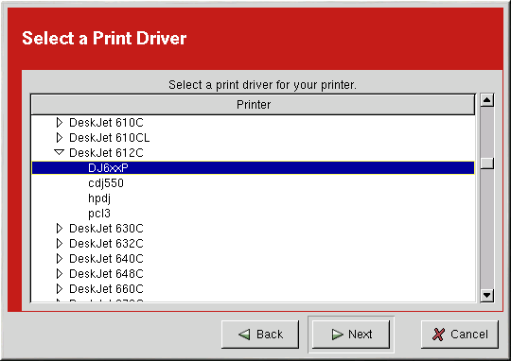

Slide 22

As shown in the figure given below, the print driver processes the data that you want to print into a format the printer can understand.
Since a local printer is attached directly to your computer, you need to select a print driver to process the data that is sent to the printer.

Slide 23
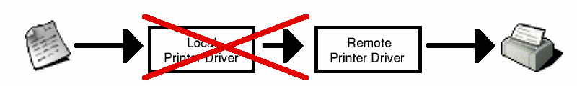
If you are configuring a remote printer (LPD, SMB, or NCP), the remote print server usually has its own print driver. If you select an additional print driver on your local computer, the data will be filtered more than once, and the data will be converted to a format that the printer cannot understand.

Slide 24
Confirming Printer Configuration
The last step is to confirm your printer configuration. Click Finish if this is the printer that you want to add. Click Back to modify the printer configuration.
Click the Apply button in the main window to save your changes to the /etc/printcap configuration file and restart the printer daemon (lpd). After applying the changes, print a test page to ensure the configuration is correct. Refer to the Section called Printing a Test Page for details.

Slide 25
Printing a Test Page
After you have configured your printer, you should print a test page to make sure the printer is functioning properly.
To print a test page, select the printer that you want to test from the printer list, and select the appropriate test page from the Test pulldown menu.
If you change the print driver or modify the driver options, you should print a test page to test the different configuration.

Slide 26
Names and Aliases
If you want to rename a printer, change the value of Queue Name in the Names and Aliases tab. Click OK to return to the main window.
The name of the printer should change in the printer list. Click Apply to save the change and restart the printer daemon.
A printer alias is an alternate name for a printer. To add an alias for an existing printer, click the Add button in the Name and Aliases tab, enter the name of the alias, and click OK. Click OK again to return to the main window. Click Apply to save the aliases and restart the printer daemon. A printer can have more than one alias.

Slide 27
Queue Type
The Queue Type tab shows queue type that you selected when adding the printer and its settings. You can change the queue type of the printer or just change the settings.
After making modifications, click OK to return to the main window. Click Apply to save the change and restart the printer daemon.
Depending on which queue type you choose, you will see different options. Refer to the appropriate section on adding a printer for a description of the options.

Slide 28
Driver
The Driver tab shows which print driver is currently being used. This is the same list that you used when adding the printer. If you change the print driver, click OK to return to the main window. Click Apply to save the change and restart the printer daemon.
To save your printer configuration, type this command as root:
/usr/sbin/printconf-tui --Xexport > settings.xml
Your configuration is saved to the file settings.xml.
To restore the configuration, type this command as root:
/usr/sbin/printconf-tui --Ximport < settings.xml
you can merge the files with the following command (as root): /usr/sbin/printconf-tui --Ximport --merge < settings.xml

Slide 29
Managing Your Print Jobs
When you send a print job to the printer daemon such as printing text file from Emacs or printing an image from The GIMP, the print job is added to the print spool queue. The print spool queue is a list of print jobs that have been sent to the printer and information about each print request such as the status of the request, the username of the person who sent the request
Rank Owner/ID Class Job Files Size Timeactive user@localhost+902 A 902 sample.txt 2050 01:20:46

